Slide 1


Slide 2
General information
Subject Web Design Development
Course instructor Lect; Arshad Iqbal
Department Computer Science
Semester 7th
University K-K-K-U- Karak

Slide 3
Developer
Name Zuhaib Aman
Reg No 18-kkkuk(cs)-f18
Name Salman Khan
Reg No 36-kkkuk(cs)-f18

Slide 4
Project Name
Introduction ::
Age Calculator: when ever we have to calculate our age in days ,years, minutes, seconds we have to use Age calculator.
While using this user are able to know about
that how many days are left for our next birthday.
With the help of Age calculator we can easily find the days, year, minutes, seconds also next upcoming birthday of our self and our relatives easily.

Slide 5
Language
Language which are used in creating the Age calculator are as under.
1) HTML
2) CSS
3)JavaScript

Slide 6
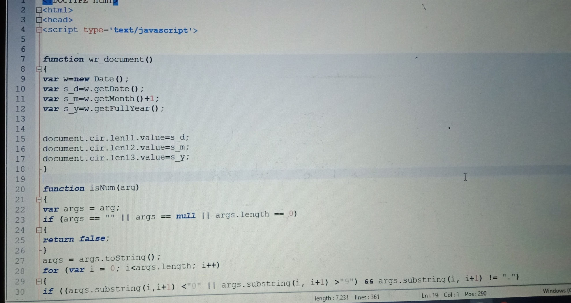
Code

Slide 7
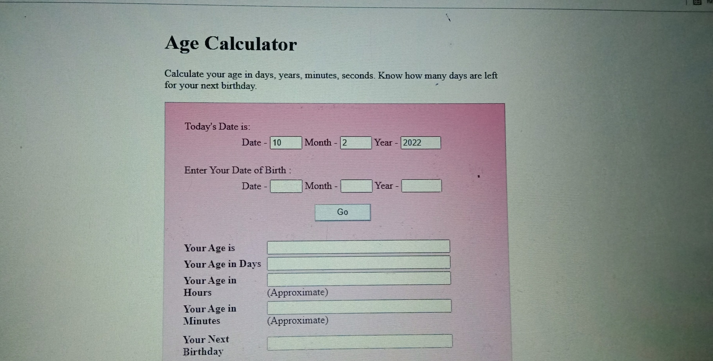
Calculator

Slide 8
Adding the date of birth and press the go button and then it well give a complete details about your date of birth.
For example i entered my own date of birth which well shown in the below picture.

Slide 9
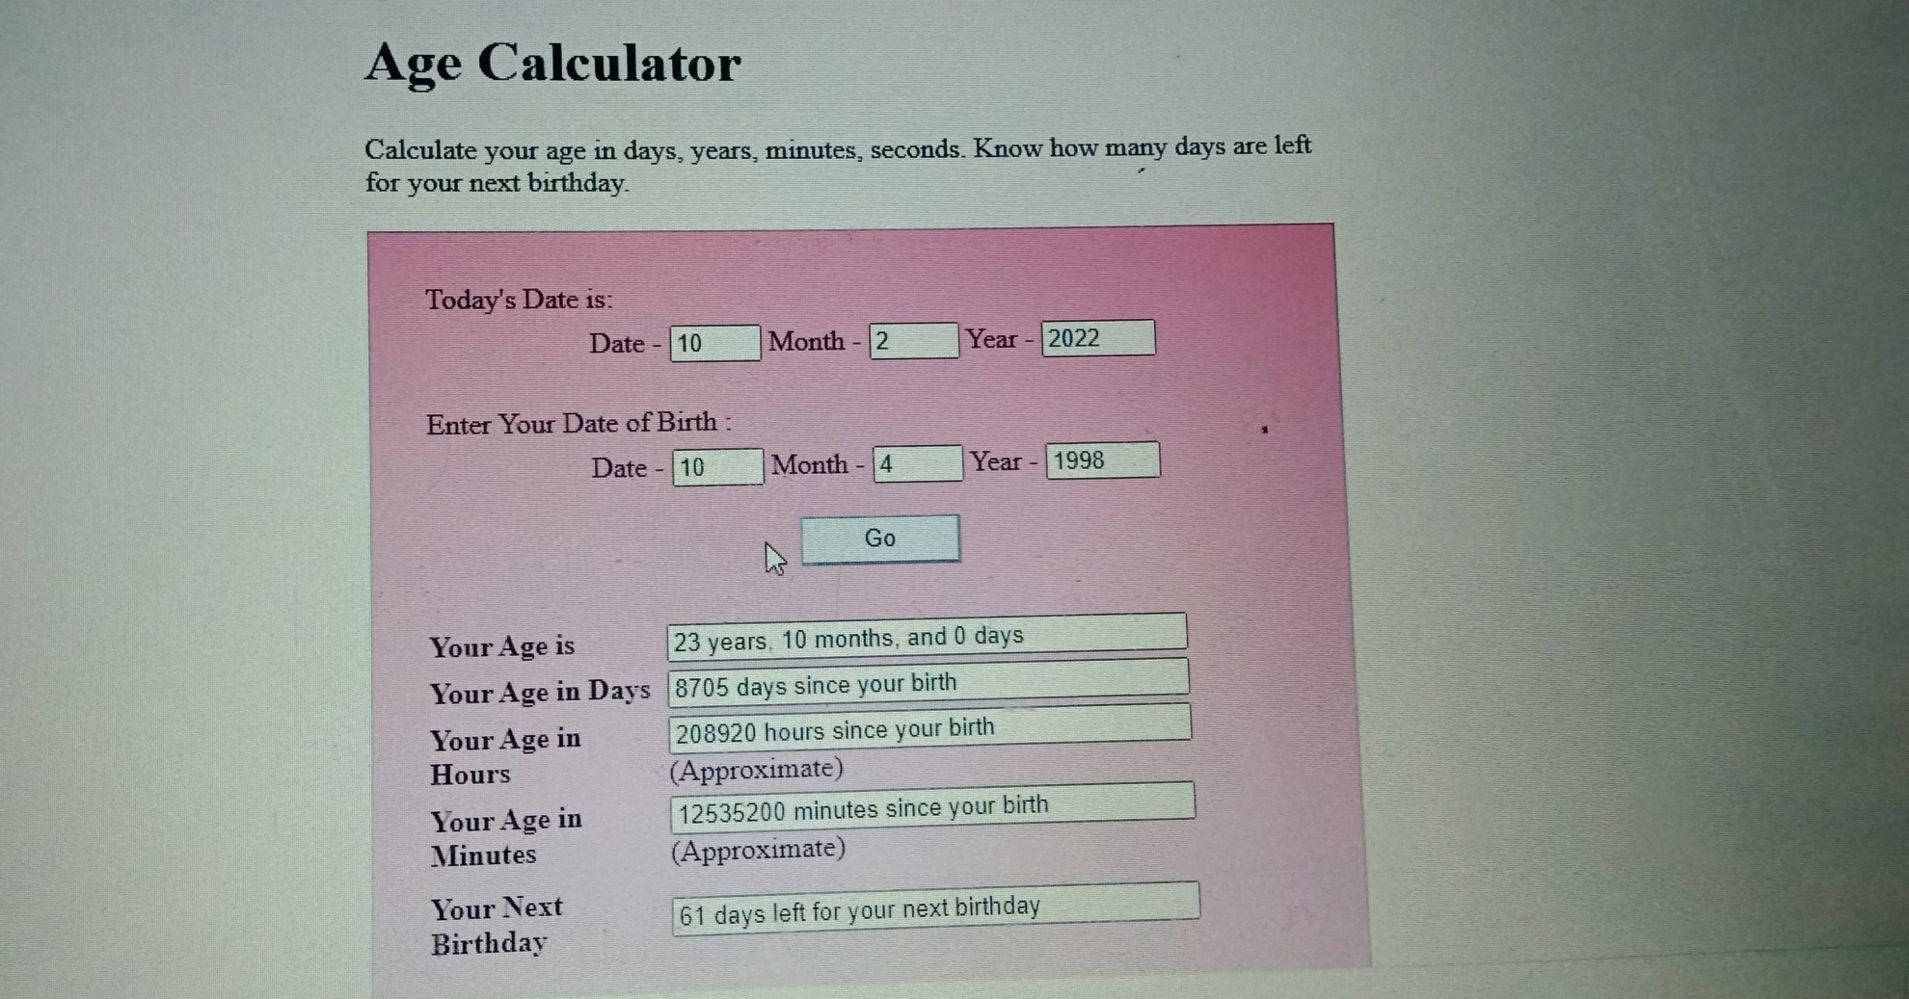
Adding DOB

Slide 10
Thank you !

